Slide 1

Module 5 Project: Two-Sample Confidence Intervals & Hypothesis Testing
Submitted By-
AAYUSH SHETTY
SHIVANI ADSAR
Rishhikumar Janakiraman

Slide 2
Objectives
Performing hypothesis on two population samples
Perform analysis of Variance using statistical methods
Interpret meaningful patterns from the given data set

Slide 3
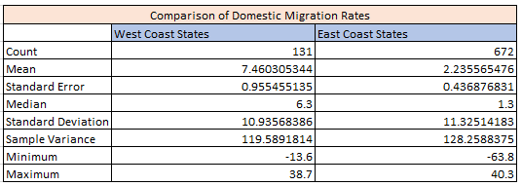
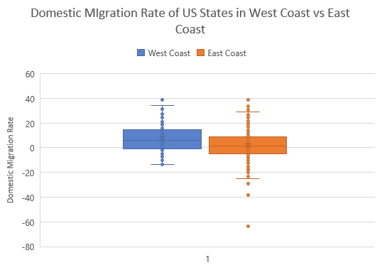
Analysis 1: Comparison Using Box Plot
Observations:
1. States in West Coast: Alaska, California, Hawaii, Oregon, Washington.
States in East Coast: Maine, New Hampshire, Massachusetts, Rhode Island
Connecticut, New York, New Jersey, Pennsylvania,
Delaware, Maryland, Virginia, North Carolina,
South Carolina, Georgia, and Florida
2. The average domestic migration rate in west coast states is more when compared to east coast states.
3. Outliers present in both cost visible in box plot.

Slide 4
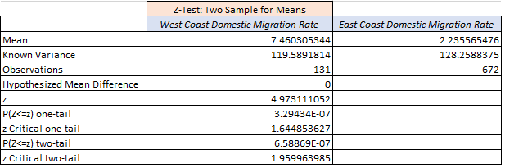
Hypothesis for the data samples
µ1 : Average of domestic migration rate in West Coast States
µ 2 : Average of domestic migration rate in East Coast states
For α=0.05, we are testing the claim that the average DMR is higher in West Coast states
Observations:
Right-Tailed Problem
1. Null Hypotheses, H ₀ : μ ₁ - μ ₂ ≤ 0
2. Alternate Hypotheses,H _{A} : μ ₁ - μ ₂ > 0
3. Pvalue < α, hence we will reject the Null Hypothesis

Slide 5
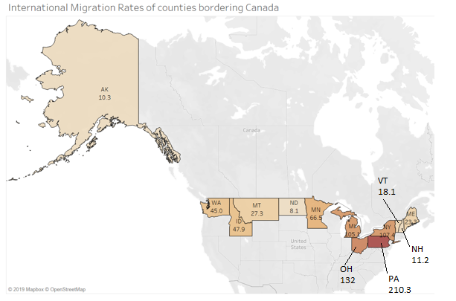
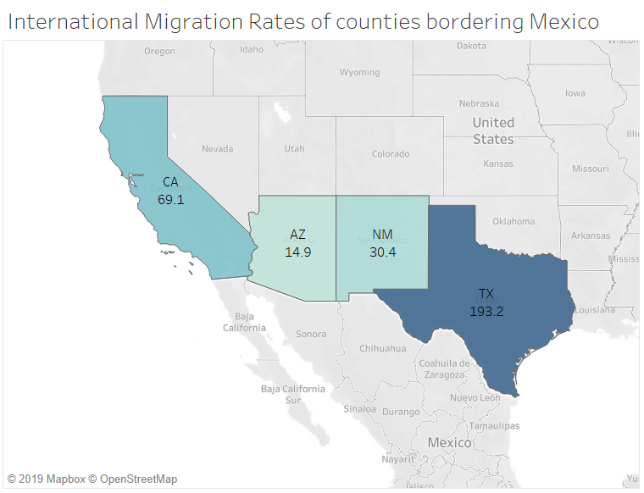
Analysis 2: IMR and States Bordering Canada & Mexico

Slide 6
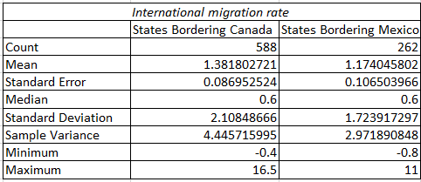
Comparison using Pie Chart

Slide 7
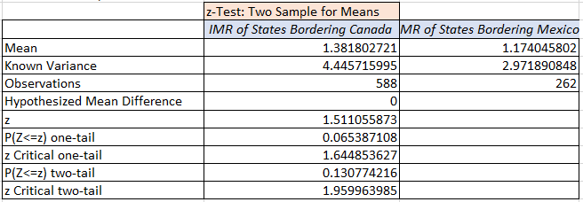
Hypothesis for the data samples
µ 1: Average of international migration rate of states bordering Canada
µ 2 : Average of international migration rate of states bordering Mexico
For α=0.05, we are testing the claim that the Average international migration rate is same for Both
Observations:
Two-Tailed Problem
H ₀ : μ ₁ - μ ₂ ≠ 0
H _{A} : μ ₁ - μ ₂ = 0
Pvalue > α, hence we will not reject the Null Hypothesis

Slide 8
Conclusion
Analysis 1:
The average Domestic Rates of States in West Coast is higher than in East Coast
Based on the hypotheses testing, the claim that the average domestic migration rate in west coast states is more when compared to east coast states
Analysis 2 :
The average of International Migration Rate of states bordering Canada is higher than Mexico.
Based on the hypotheses testing, We don’t have enough evidence to conclude that the average international migration rate is same for states bordering Canada and states bordering Mexico

